Slide 1
IMAGE CAPTIONING WITH SPATIAL AND CHANNEL WISE ATTENTION
DASARI CHARAN SRINIVAS KUMAR REDDY (242IT007)
KONDURU SAI KIRAN (242IT014)
MITESH KUMAR MANDA (242IT020)
KUNDURU PHANEENDRA REDDY (242IT016)
SAI SAKETH NANDAM (242IT021)

Slide 2
INTRODUCTION
In the realm of image processing, human vision operates selectively rather than taking in the entirety of a scene all at once. Instead of absorbing the full visual space, we focus on key elements, shifting our attention as needed.

Slide 3
OBJECTIVE
The objective of the SCA-CNN (Spatial and Channel-wise Attention CNN) project is to enhance image captioning by:
Implementing spatial attention mechanisms to allow the model to focus on specific, relevant regions of an image during caption generation.
Incorporating channel-wise attention to dynamically emphasize or suppress specific feature channels based on the context of the generated caption.
Improving the overall accuracy and contextual relevance of generated captions, leading to richer and more descriptive image representations.
Evaluating the performance of the SCA-CNN model against traditional image captioning approaches to demonstrate its effectiveness in generating high-quality captions.

Slide 4
TRENDS
Template-Based and Retrieval Methods
CNN + RNN (LSTM/GRU) Models
Attention-Based Models
Transformer-Based Models
Vision-Language Pretrained Models

Slide 5
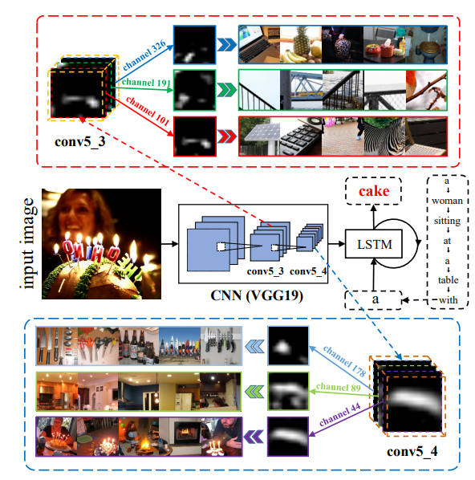
METHODLOGY
We use encoder-decoder framework. In this approach, an encoder (CNN) first processes the input image and transforms it into a feature vector. This vector is then passed to a decoder (LSTM), which generates a corresponding sequence of words, producing a descriptive caption for the image.

Slide 6
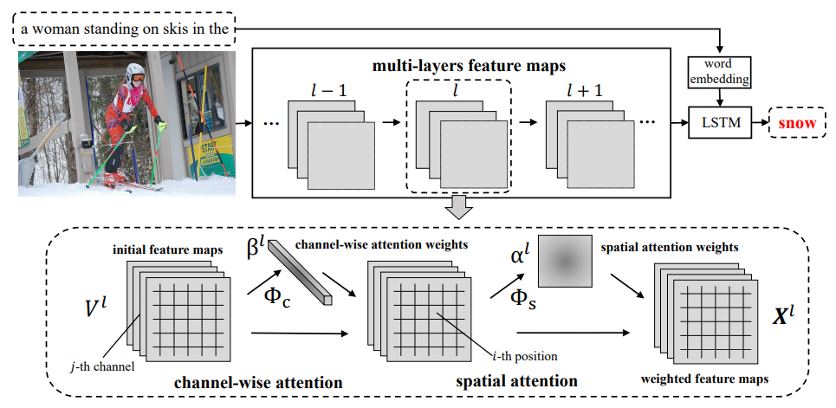
METHODLOGY
As part of our approach, we implement SCA-CNN (Spatial and Channel-wise Attention CNN) to enhance the standard CNN. This involves making the CNN’s multi-layer feature maps adaptive to the sentence context through two types of attention mechanisms:
Channel-wise attention: This selectively emphasizes or suppresses certain feature channels based on the context of the caption being generated.
Spatial attention: This allows the model to focus on important regions of the image, at different layers of the CNN, that are most relevant to the caption.

Slide 7
DATASET
The MS COCO (Microsoft Common Objects in Context) dataset is a large-scale object detection, segmentation, key-point detection, and captioning dataset . The dataset consists of 328K images.
It contains 82,783 images in training set, 40,504 images in validation set and 40,775 images in test set.
The dataset has annotations for object detection, captioning, keypoints detection, stuff image segmentation, panoptic, dense pose.

Slide 8
BASE PAPER
SCA-CNN: Spatial and Channel-wise Attention in Convolutional Networks for Image Captioning
https://arxiv.org/abs/1611.05594
THANK YOU

